Slide 1

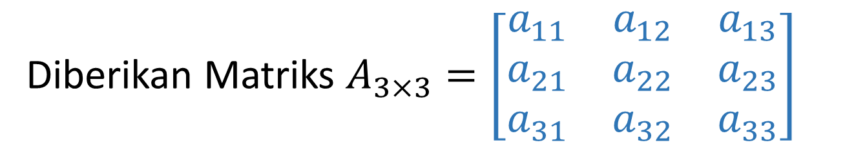
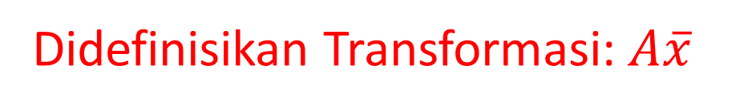

Dosen: I Gusti Ngurah Rai Usadha
(Review Modul 5, Buku Ajar Aljabar linear.)
Eigen (jerman)= kharaktristik
Diberikan Matriks $A_{3×3}=\left[\begin{matrix}a_{11} & a_{12} & a_{13} \\ a_{21} & a_{22} & a_{23} \\ a_{31} & a_{32} & a_{33}\end{matrix}\right]$
Dan vektor $\overline{x}=\left[\begin{matrix}x_{1} \\ x_{2} \\ x_{3}\end{matrix}\right]$
Didefinisikan Transformasi: $A\overline{x}$

Slide 2





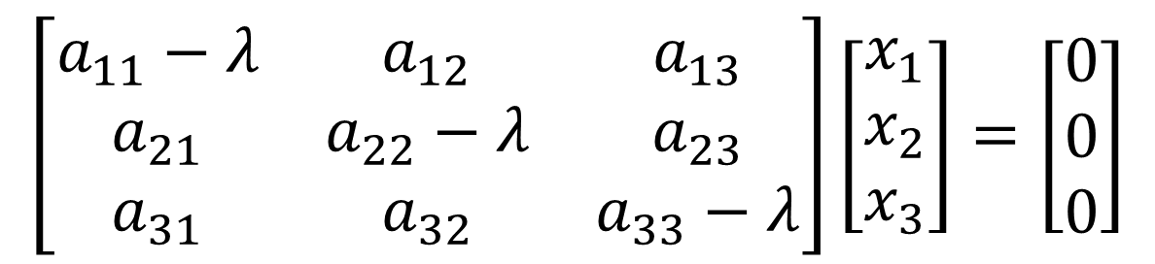


Jika ada skalar $λ$, sehingga
$$A\overline{x}=λ\overline{x}$$
Maka $λ$ disebut nilai Eigen atau nilai kharaktristik dari A, dan $\overline{x}$ yang bersesuaian disebut vektor Eigen
$$\overline{x}$$
$$A\overline{x}=λ\overline{x}$$
$$A\overline{x}−λI\overline{x}=\overline{0}$$
$$\left(A−λI\right)\overline{x}=\overline{0}$$
$$\left[\begin{matrix}a_{11}−λ & a_{12} & a_{13} \\ a_{21} & a_{22}−λ & a_{23} \\ a_{31} & a_{32} & a_{33}−λ\end{matrix}\right]\left[\begin{matrix}x_{1} \\ x_{2} \\ x_{3}\end{matrix}\right]=\left[\begin{matrix}0 \\ 0 \\ 0\end{matrix}\right]$$
SISTEM LINEAR HOMOGEN

Slide 3
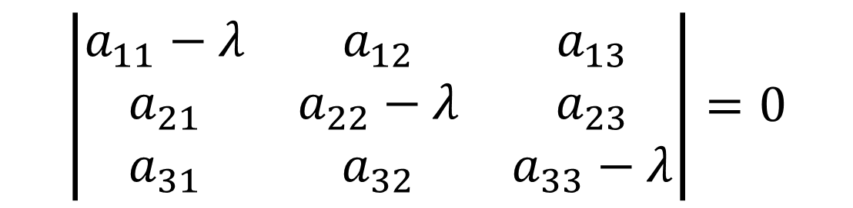
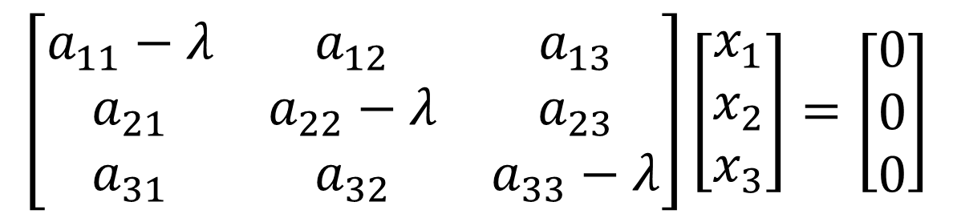

$$\left[\begin{matrix}a_{11}−λ & a_{12} & a_{13} \\ a_{21} & a_{22}−λ & a_{23} \\ a_{31} & a_{32} & a_{33}−λ\end{matrix}\right]\left[\begin{matrix}x_{1} \\ x_{2} \\ x_{3}\end{matrix}\right]=\left[\begin{matrix}0 \\ 0 \\ 0\end{matrix}\right]$$
SISTEM LINEAR HOMOGEN
Syarat ada solusi tak nol (non trivial),$det⁡(A−λI)=0$
$$\left|\begin{matrix}a_{11}−λ & a_{12} & a_{13} \\ a_{21} & a_{22}−λ & a_{23} \\ a_{31} & a_{32} & a_{33}−λ\end{matrix}\right|=0$$
Polinomial kharaktristik, $P_{3}\left(λ\right)=aλ^{3}+bλ^{2}+cλ+d=0$
Akar-akar kharaktristik, nilai Eigen: $λ_{1}, λ_{2},λ_{3}$

Slide 4







Contoh 1. Tentukan nilai dan vektor Eigen dari matriks $.$
$$A=\left[\begin{matrix}4 & −1 \\ 2 & 1\end{matrix}\right]$$
Penyelesaian
$$\left|\begin{matrix}4−λ & −1 \\ 2 & 1−λ\end{matrix}\right|=0$$
$$\left(4−λ\right)\left(1−λ\right)+2=0,$$
$$λ^{2}−5λ+6=0$$
$$\left(λ−2\right)\left(λ−3\right)=0$$
$$λ_{1}=2, λ_{2}=3$$

Slide 5
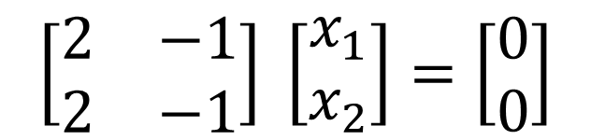

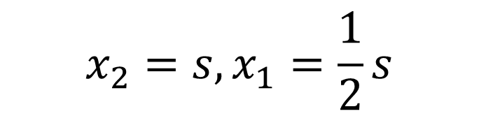
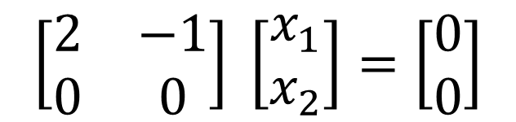
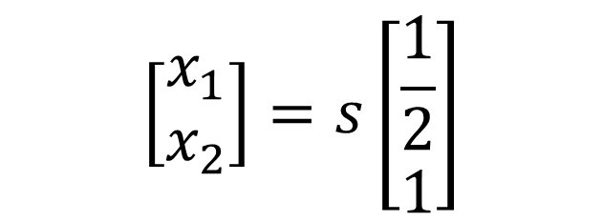
Untuk $λ=2$
$$\left[\begin{matrix}2 & −1 \\ 2 & −1\end{matrix}\right] \left[\begin{matrix}x_{1} \\ x_{2}\end{matrix}\right]=\left[\begin{matrix}0 \\ 0\end{matrix}\right]$$
$$\left[\begin{matrix}2 & −1 \\ 0 & 0\end{matrix}\right] \left[\begin{matrix}x_{1} \\ x_{2}\end{matrix}\right]=\left[\begin{matrix}0 \\ 0\end{matrix}\right]$$
Satu baris tak nol satu parameter bebas
$$x_{2}=s, x_{1}=\frac{1}{2}s$$
$$\left[\begin{matrix}x_{1} \\ x_{2}\end{matrix}\right]=s\left[\begin{matrix}\frac{1}{2} \\ 1\end{matrix}\right]$$

Slide 6
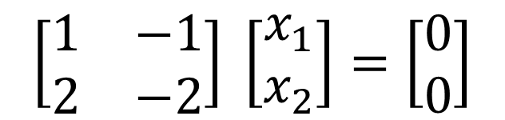


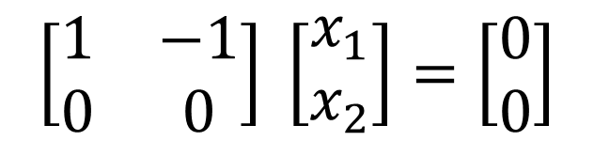

Untuk $λ=3$
$$\left[\begin{matrix}1 & −1 \\ 2 & −2\end{matrix}\right] \left[\begin{matrix}x_{1} \\ x_{2}\end{matrix}\right]=\left[\begin{matrix}0 \\ 0\end{matrix}\right]$$
$$\left[\begin{matrix}1 & −1 \\ 0 & 0\end{matrix}\right] \left[\begin{matrix}x_{1} \\ x_{2}\end{matrix}\right]=\left[\begin{matrix}0 \\ 0\end{matrix}\right]$$
$$x_{2}=s, x_{1}=s$$
$$\left[\begin{matrix}x_{1} \\ x_{2}\end{matrix}\right]=s\left[\begin{matrix}1 \\ 1\end{matrix}\right]$$

Slide 7
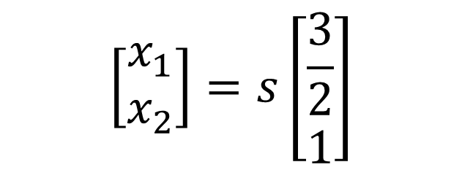

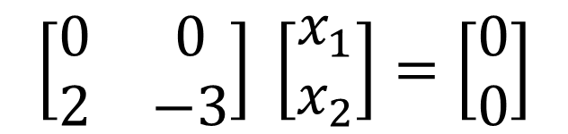





Contoh 2. Tentukan nilai dan vektor Eigen dari matriks $.$
$$A=\left[\begin{matrix}4 & 0 \\ 2 & 1\end{matrix}\right]$$
Matriks segitiga (bawah)
Penyelesaian
$$\left|\begin{matrix}4−λ & 0 \\ 2 & 1−λ\end{matrix}\right|=0$$
$$\left\{4−λ\right)\left(1−λ\right)=0$$
$$λ=4$$
$$\left[\begin{matrix}0 & 0 \\ 2 & −3\end{matrix}\right] \left[\begin{matrix}x_{1} \\ x_{2}\end{matrix}\right]=\left[\begin{matrix}0 \\ 0\end{matrix}\right]$$
$$λ_{1}=4, λ_{2}=1$$
$$\left[\begin{matrix}x_{1} \\ x_{2}\end{matrix}\right]=s\left[\begin{matrix}\frac{3}{2} \\ 1\end{matrix}\right]$$

Slide 8



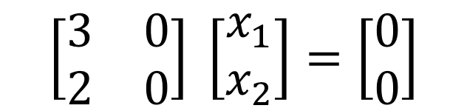




$$\left[\begin{matrix}x_{1} \\ x_{2}\end{matrix}\right]=s\left[\begin{matrix}0 \\ 1\end{matrix}\right]$$
$$\left[\begin{matrix}3 & 0 \\ 2 & 0\end{matrix}\right] \left[\begin{matrix}x_{1} \\ x_{2}\end{matrix}\right]=\left[\begin{matrix}0 \\ 0\end{matrix}\right]$$
Dan
$$λ=1$$
Contoh 3. Tentukan nilai dan vektor Eigen dari matriks $.$
$$A=\left[\begin{matrix}4 & 0 \\ 0 & 1\end{matrix}\right]$$
Matriks diagonal
$$\left|\begin{matrix}4−λ & 0 \\ 0 & 1−λ\end{matrix}\right|=0$$
$$\left(4−λ\right)\left(1−λ\right)=0$$
$$λ_{1}=4, λ_{2}=1$$

Slide 9


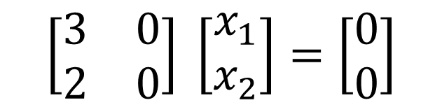
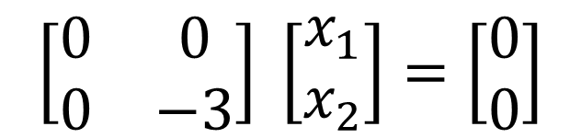




$$λ=4$$
$$\left[\begin{matrix}0 & 0 \\ 0 & −3\end{matrix}\right] \left[\begin{matrix}x_{1} \\ x_{2}\end{matrix}\right]=\left[\begin{matrix}0 \\ 0\end{matrix}\right]$$
$$\left[\begin{matrix}x_{1} \\ x_{2}\end{matrix}\right]=s\left[\begin{matrix}1 \\ 0\end{matrix}\right]$$
$$λ=1$$
$$\left[\begin{matrix}3 & 0 \\ 2 & 0\end{matrix}\right] \left[\begin{matrix}x_{1} \\ x_{2}\end{matrix}\right]=\left[\begin{matrix}0 \\ 0\end{matrix}\right]$$
$$\left[\begin{matrix}x_{1} \\ x_{2}\end{matrix}\right]=s\left[\begin{matrix}0 \\ 1\end{matrix}\right]$$
Contoh 4. Tentukan nilai dan vektor Eigen dari matriks $.$
$$A=\left[\begin{matrix}0 & 1 \\ 4 & 0\end{matrix}\right]$$

Slide 10


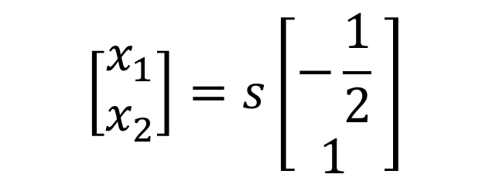

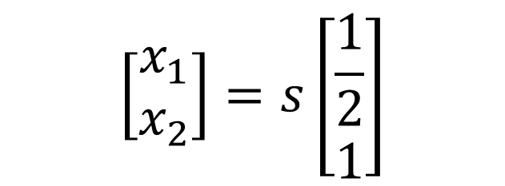
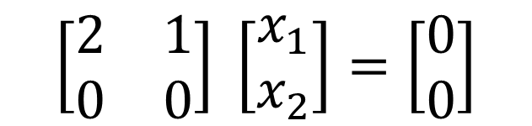

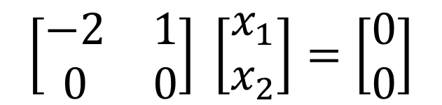
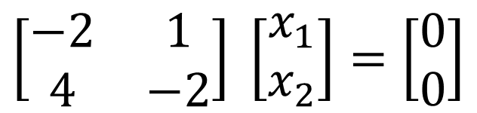
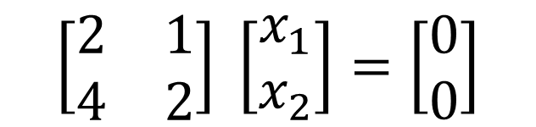


Penyelesaian
$$\left|\begin{matrix}−λ & 1 \\ 4 & −λ\end{matrix}\right|=0$$
$$λ^{2}−4=0$$
$$λ= ±2$$
$$λ=2$$
$$\left[\begin{matrix}−2 & 1 \\ 4 & −2\end{matrix}\right] \left[\begin{matrix}x_{1} \\ x_{2}\end{matrix}\right]=\left[\begin{matrix}0 \\ 0\end{matrix}\right]$$
$$\left[\begin{matrix}−2 & 1 \\ 0 & 0\end{matrix}\right] \left[\begin{matrix}x_{1} \\ x_{2}\end{matrix}\right]=\left[\begin{matrix}0 \\ 0\end{matrix}\right]$$
$$\left[\begin{matrix}x_{1} \\ x_{2}\end{matrix}\right]=s\left[\begin{matrix}\frac{1}{2} \\ 1\end{matrix}\right]$$
$$λ=−2$$
$$\left[\begin{matrix}2 & 1 \\ 4 & 2\end{matrix}\right] \left[\begin{matrix}x_{1} \\ x_{2}\end{matrix}\right]=\left[\begin{matrix}0 \\ 0\end{matrix}\right]$$
$$\left[\begin{matrix}2 & 1 \\ 0 & 0\end{matrix}\right] \left[\begin{matrix}x_{1} \\ x_{2}\end{matrix}\right]=\left[\begin{matrix}0 \\ 0\end{matrix}\right]$$
$$\left[\begin{matrix}x_{1} \\ x_{2}\end{matrix}\right]=s\left[\begin{matrix}−\frac{1}{2} \\ 1\end{matrix}\begin{matrix} \\ \end{matrix}\right]$$

